Slide 1
Analysis Modeling Session 15
Course : COMP6056
Effective Period : September 2021

Slide 2
Sub Topics
Requirement Determination
Requirement Analysis Strategies
Requirement Gathering Techniques
Creating Requirement Definition
System Proposal
Applying the concepts

Slide 3
These slides have been adapted from: Alan Dennis, Barbara Haley Wixom, David Tegarden (2015). Systems Analysis and Design_ An Object-Oriented Approach with UML, 5th ed. ISBN: 978-1-118-80467-4 Chapter 3
Acknowledgement

Slide 4
Learning Objectives
At the end of this lecture, students are able to:
LO3: To analyze the requirement of a system

Slide 5
Requirement Determination
The purpose of requirements determination is to turn the very high-level explanation of the business requirements stated in the system request into a more precise list of requirements that can be used as inputs to the rest of analysis (creating functional, structural, and behavioral models).
This expansion of the requirements ultimately leads to the design of the system.
A. Dennis et al.,(2015). Systems Analysis and Design An Object-Oriented Approach with UML, 5th ed. ISBN: 978-1-118-80467-4

Slide 6
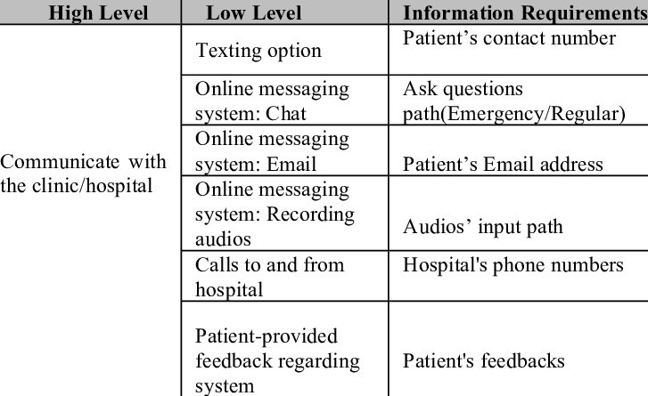

Slide 7
Defining Requirement
A requirement is simply a statement of what the system must do or what characteristic it must have.
Requirements are written from the perspective of the businessperson, and they focus on the “what” of the system
Usually called business requirements (and sometimes user requirements)
Gaddis, T., Starting Out With Programming Logic and Design, 5 ed, ISBN: 978-0-13-480115-5

Slide 8
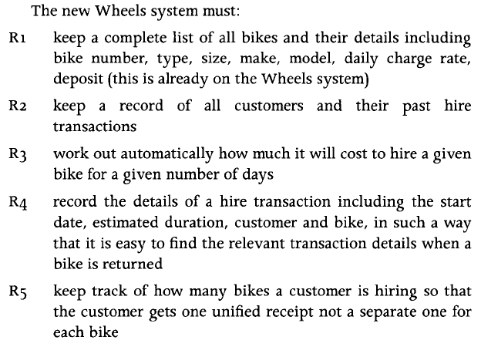
Defining Requirement
Gaddis, T., Starting Out With Programming Logic and Design, 5 ed, ISBN: 978-0-13-480115-5

Slide 9
Defining Requirement
Requirements can be either Functional or Non-Functional in nature
Functional requirement relates directly to a process a system has to perform or information it needs to contain.
For example, requirements stating that a system must have the ability to search for available inventory or to report actual and budgeted expenses are functional requirements.
Functional requirements flow directly into the creation of functional, structural, and behavioral models that represent the functionality of the evolving system
Non-Functional requirements refer to behavioral properties that the system must have, such as performance and usability.
Gaddis, T., Starting Out With Programming Logic and Design, 5 ed, ISBN: 978-0-13-480115-5

Slide 10
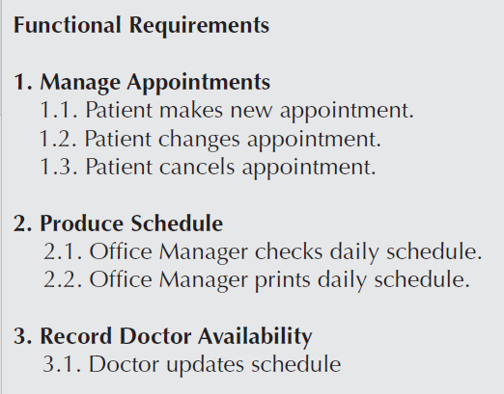
Requirement Definition Report
The requirements definition report—usually just called the requirements definition—is a straightforward text report that simply lists the functional and nonfunctional requirements in an outline format.
Exampe: An appointment System in a typical Doctor’s office
A. Dennis et al.,(2015). Systems Analysis and Design An Object-Oriented Approach with UML, 5th ed. ISBN: 978-1-118-80467-4

Slide 11
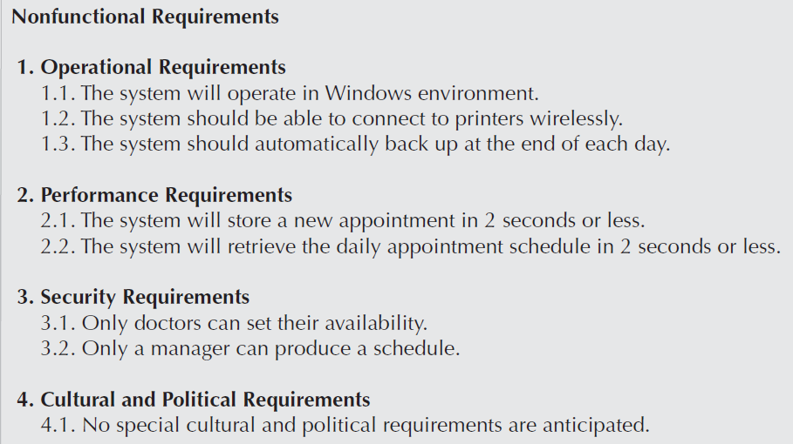
Requirement Definition Report
A. Dennis et al.,(2015). Systems Analysis and Design An Object-Oriented Approach with UML, 5th ed. ISBN: 978-1-118-80467-4

Slide 12
Requirement Analysis Strategies
Critical thinking is the ability to recognize strengths and weaknesses and recast an idea in an improved form, and critical thinking skills are needed to really understand issues and develop new business processes.
These skills are also needed to thoroughly examine the results of requirements gathering, to identify business requirements, and to translate those requirements into a concept for the new system
A. Dennis et al.,(2015). Systems Analysis and Design An Object-Oriented Approach with UML, 5th ed. ISBN: 978-1-118-80467-4

Slide 13
Requirement Analysis Strategies
1. Problem Analysis
Asking the users and managers to identify problems with the as-is system (current) and to describe how to solve them in the to-be system.
Most users have a very good idea of the changes they would like to see, and most are quite vocal about suggesting them
2. Root Cause Analysis
Focuses on problems, not solutions
Have users generate a list of problems with the current system and then prioritize the problems in order of importance
Gaddis, T., Starting Out With Programming Logic and Design, 5 ed, ISBN: 978-0-13-480115-5

Slide 15
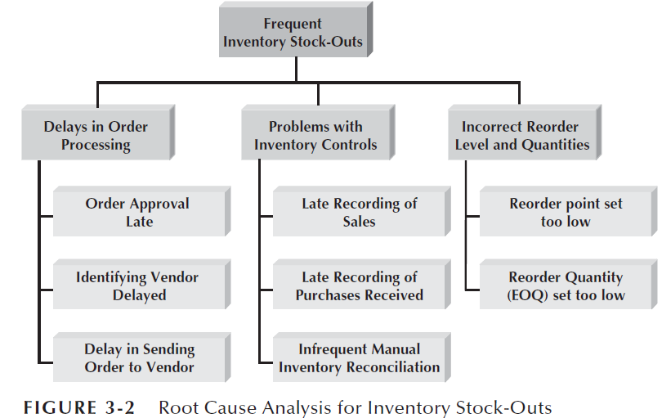

Slide 16
Requirement Analysis Strategies
3. Duration Analysis
Detailed examination of the amount of time it takes to perform each process in the current as-is system. The analysts begin by determining the total amount of time it takes, on average, to perform a set of business processes for a typical input.
4. Activity-Based Costing
Examines the cost of each major process or step in a business process rather than the time taken
The analysts identify the costs associated with each of the basic functional steps or processes, identify the most costly processes, and focus their improvement efforts on them.
Gaddis, T., Starting Out With Programming Logic and Design, 5 ed, ISBN: 978-0-13-480115-5

Slide 17
Requirement Analysis Strategies
5. Informal Benchmarking
Benchmarking refers to studying how other organizations perform a business process in order to learn how your organization can do something better. Benchmarking helps the organization by introducing ideas that employees may never have considered but that have the potential to add value.
6. Outcome Analysis
Outcome analysis focuses on understanding the fundamental outcomes that provide value to customers
A. Dennis et al.,(2015). Systems Analysis and Design An Object-Oriented Approach with UML, 5th ed. ISBN: 978-1-118-80467-4

Slide 18
Requirement Analysis Strategies
7. Technology Analysis
Starts by having the analysts and managers develop a list of important and interesting technologies. Then the group systematically identifies how every technology could be applied to the business process and identifies how the business would benefit.
8. Activity Elimination
The analysts and managers work together to identify how the organization could eliminate each activity in the business process, how the function could operate without it, and what effects are likely to occur
A. Dennis et al.,(2015). Systems Analysis and Design An Object-Oriented Approach with UML, 5th ed. ISBN: 978-1-118-80467-4

Slide 19
Requirement Gathering Techniques
Interviews
Select Interviewees
Design Interview Questions
Prepare for the Interview
Conduct the Interview
Post-Interview Follow-up
A. Dennis et al.,(2015). Systems Analysis and Design An Object-Oriented Approach with UML, 5th ed. ISBN: 978-1-118-80467-4

Slide 20

Requirement Gathering Techniques
Interviews is a “conversation with a purpose”
A. Dennis et al.,(2015). Systems Analysis and Design An Object-Oriented Approach with UML, 5th ed. ISBN: 978-1-118-80467-4

Slide 21
Interview:
Unstructured Interviews: Open-ended conversations around a particular topic
Structured Interviews: Predetermined questions like questionnaire, same questions are used with each participant
Semi-Structured Interviews: Mixed (combination)
Focus Group / Forum Group: Interview people in group

Slide 22
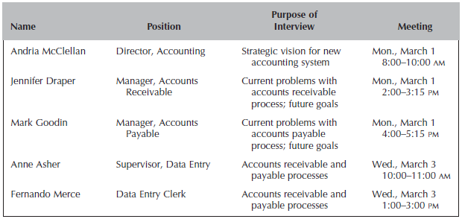


Slide 23
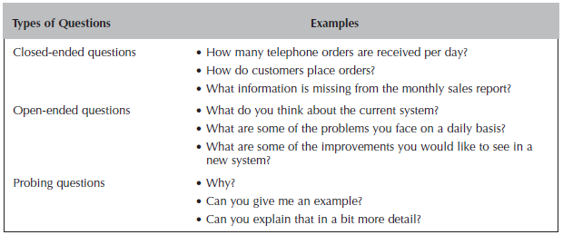


Slide 24
Requirement Gathering Techniques
Questionnaire
Select participants
Design questionnaire
Administering the Questionnaire
Questionnaire Follow-up
A. Dennis et al.,(2015). Systems Analysis and Design An Object-Oriented Approach with UML, 5th ed. ISBN: 978-1-118-80467-4

Slide 25
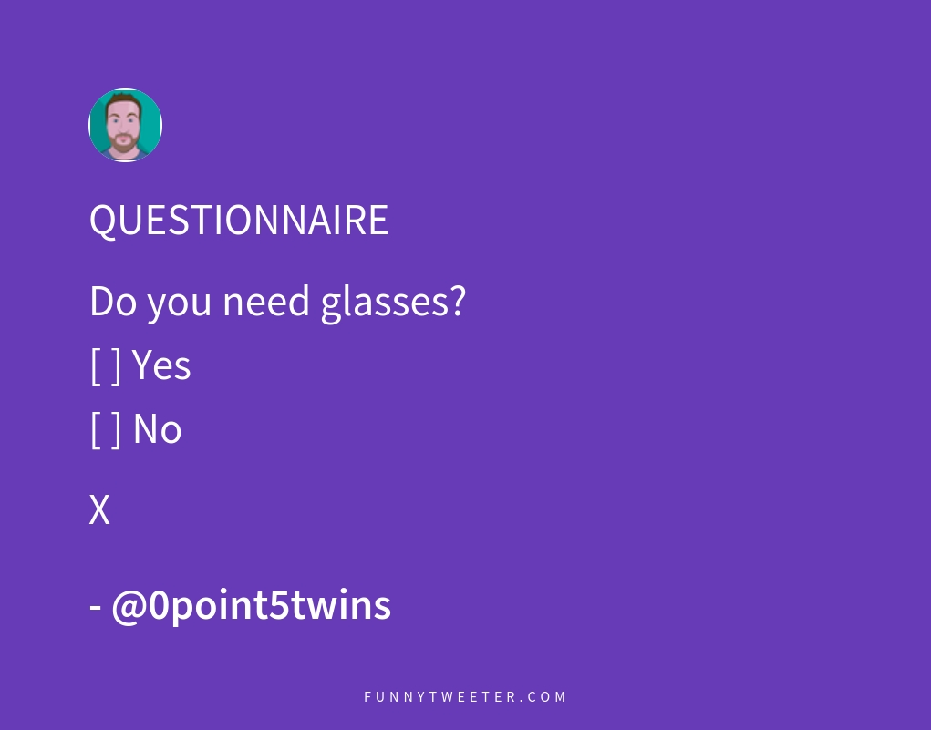
Questionnaire is technique for collecting data and opinions

Slide 26
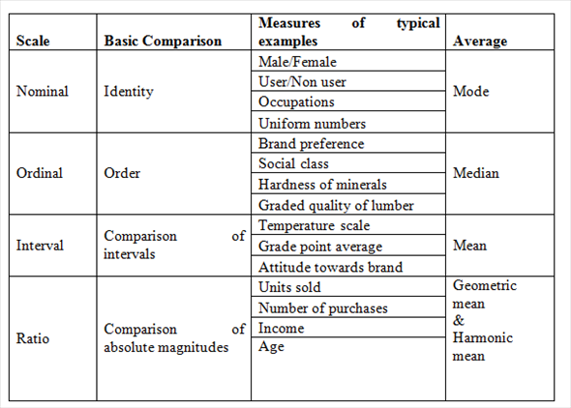
Data Scale

Slide 27
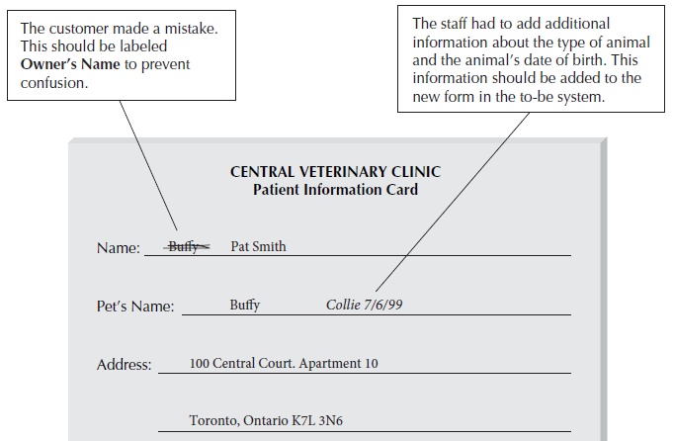
Requirement Gathering Techniques
Document Analysis
A. Dennis et al.,(2015). Systems Analysis and Design An Object-Oriented Approach with UML, 5th ed. ISBN: 978-1-118-80467-4

Slide 28
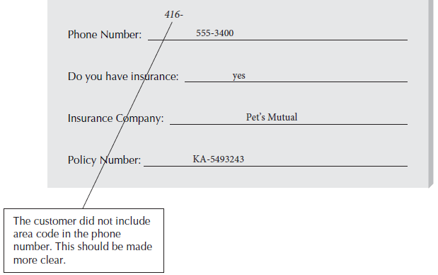
Requirement Gathering Techniques
Document Analysis
A. Dennis et al.,(2015). Systems Analysis and Design An Object-Oriented Approach with UML, 5th ed. ISBN: 978-1-118-80467-4

Slide 29
Requirement Gathering Techniques
Observation
The act of watching processes being performed, is a powerful tool for gathering information about the as-is system
Enables the analyst to see the reality of a situation
A. Dennis et al.,(2015). Systems Analysis and Design An Object-Oriented Approach with UML, 5th ed. ISBN: 978-1-118-80467-4

Slide 30

Observation is used to investigate

Slide 31

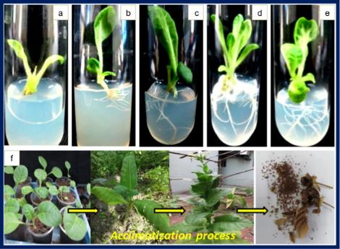
Direct Observation (uncontrolled environment)
Direct Observation (controlled environment)

Slide 32

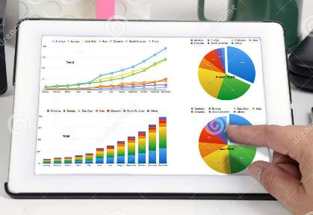
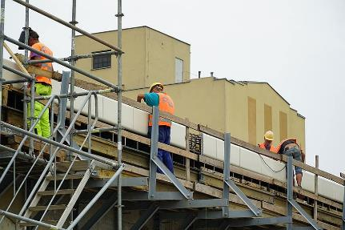
Indirect Observation (observe employees’ performance through report)

Slide 33

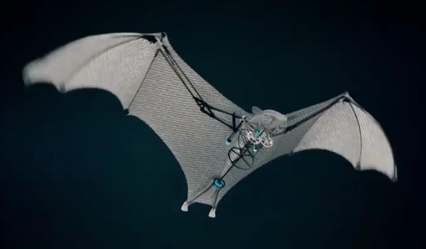
Observation of how bat takes flight: https://www.youtube.com/watch?v=BNNAxCuaYoc
https://www.youtube.com/watch?v=aWBG53OwBRc

Slide 34
System Proposal
A system proposal brings together into a single comprehensive document the material created during planning and analysis.
The system proposal typically includes an executive summary, the system request, the workplan, the feasibility analysis, the requirements definition, and the evolving models that describe the new system
A. Dennis et al.,(2015). Systems Analysis and Design An Object-Oriented Approach with UML, 5th ed. ISBN: 978-1-118-80467-4

Slide 35
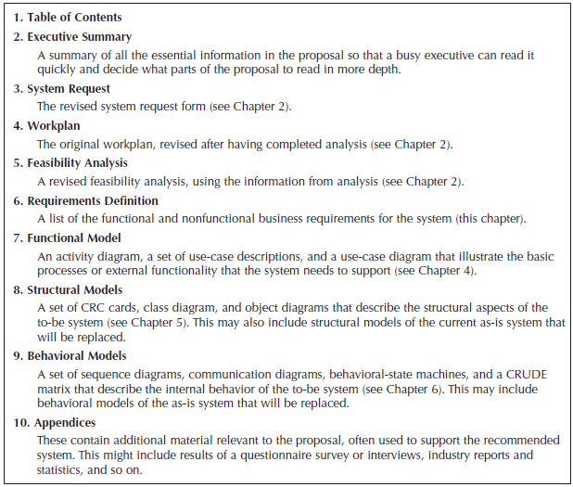
System Proposal: Sample Contents

Slide 36

User Requirement: https://www.youtube.com/watch?v=BKorP55Aqvg

Slide 37
References
Alan Dennis, Barbara Haley Wixom, David Tegarden (2015). Systems Analysis and Design_ An Object-Oriented Approach with UML, 5th ed. ISBN: 978-1-118-80467-4

